Slide 2
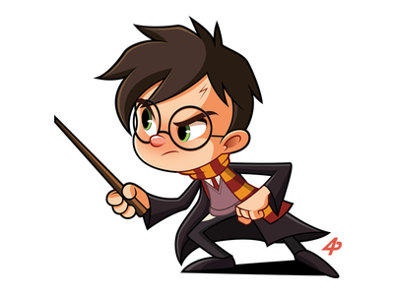
L
“He attacked everything in life with a mix of extraordinary genius and naive incompetence, and it was often difficult to tell which was which.”
-Douglas Adams
Hitchhikers Guide to the Galaxy
I was not always the best
Student. In 7th grade,
When the teacher wasn’t
Looking, I’d crawl into the
ceiling, climb along a
Bunch of pipes, then drop
Down like a ninja. That said,
I always managed to get
C’s or higher.
For the past several years,
I’ve been working hard on
Becoming a published
Author. In 2016, I won a trip
To New York for winning
A Best First Novel
Competition. This year,
I received my first book
Deal. My goal is to finish
Writing the book by
December.
anguage Arts teacher
mazing
ellow
bsessive
urturing
ntelligent
reative
ir guitar enthusiast
A
M
O
N
I
C
I call this the Harry Potter
effect. In my life, as in Harry’s,
I feel like it is sometimes
difficult to tell if I’m handling
things with skillful brilliance
or just getting lucky.
In truth, it’s probably a little
bit of both.
A

Slide 3
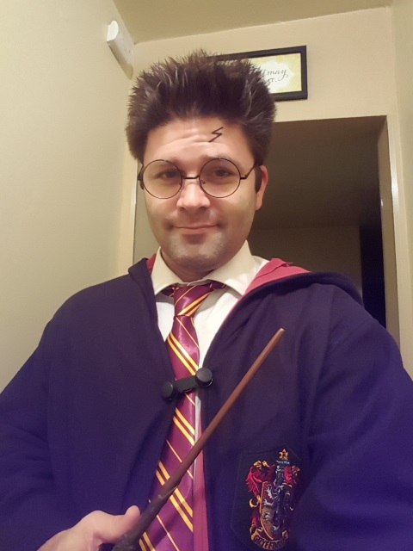
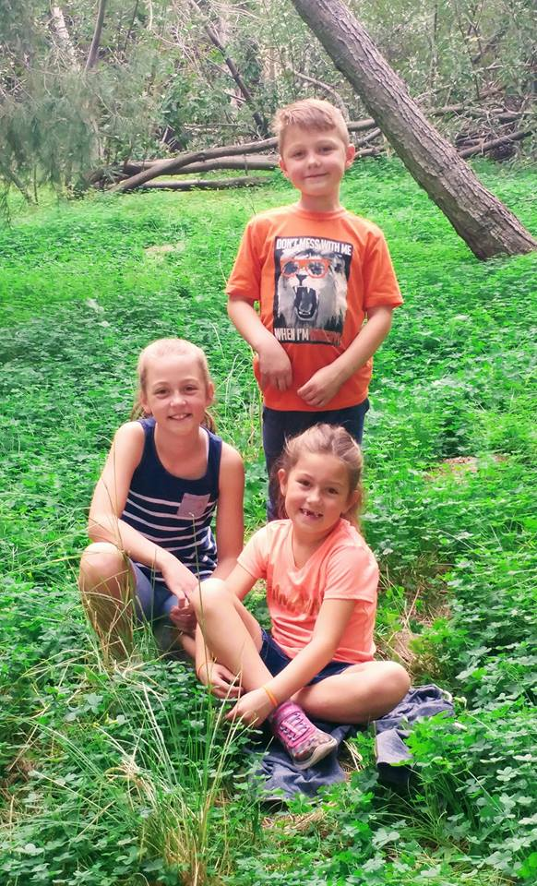
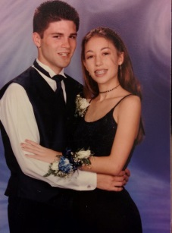
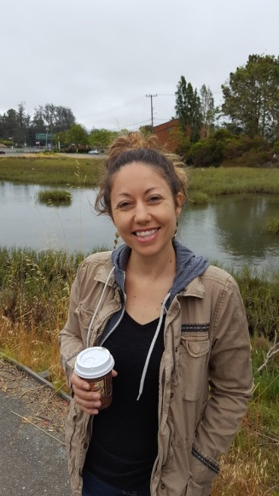
Mr.
LaMonica
Name: Mr. LaMonica
Nicknames:
Tank, Hands, Tom Jones,
and The Cradle.
Birthday: September 1st, 1981
Age: ???
Best Friend: Christina
Favorite Color: Aquamarine
Favorite food: Mashed potatoes.
Favorite band:
The Beatles
Likes:
Books, the beach, and my kids.
Dislikes:
Vertically filmed videos. Fidget Spinners
Career Goal:
Become a published novelist
Goal for the year:
Be the best teacher I can be.
Mr. LaMonica
Period 5

